Slide 1
Team thunder eagle (tju racing club)
Simeon Videnov, Yue Shi, Sangmin Kim, Paula Moya Nieto

Slide 3
Our Client Tongji University Racing club(tju)

Slide 4
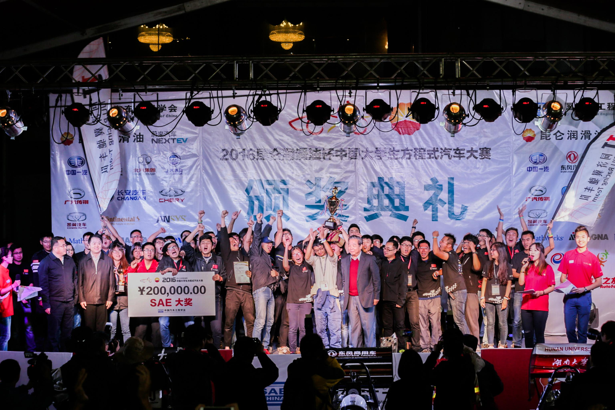
Our Client: Tju racing club

Slide 5
4. USER TESTING

Slide 6

User testing
Targeting 2 kinds of Audience
Perspective of a CLIENT who will be using the website to edit and add info on the website
Perspective of a SPONSOR who will be using the website to only view contents
First impression
Usability of Login
Sign-up functionality
Gallery Experience
Upcoming Events
Future Implementation

Slide 7

Things they disliked
1. Red-on-black text is difficult to read
2. Too many pages crammed in navbar
3. Editing/adding form looked messy when placed next to images and schedules
4. Upcoming events should have more detailed but brief information
5. Overall design was too simple

Slide 8
Should we accept ALL feedbacks and change EVERYTHING they mentioned?

Slide 9

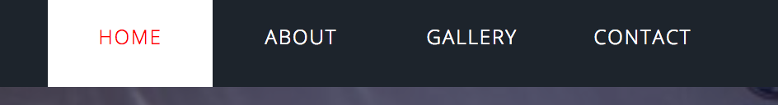
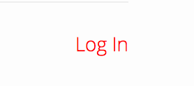
IMPROVEMENT ON NAVBAR

Slide 10
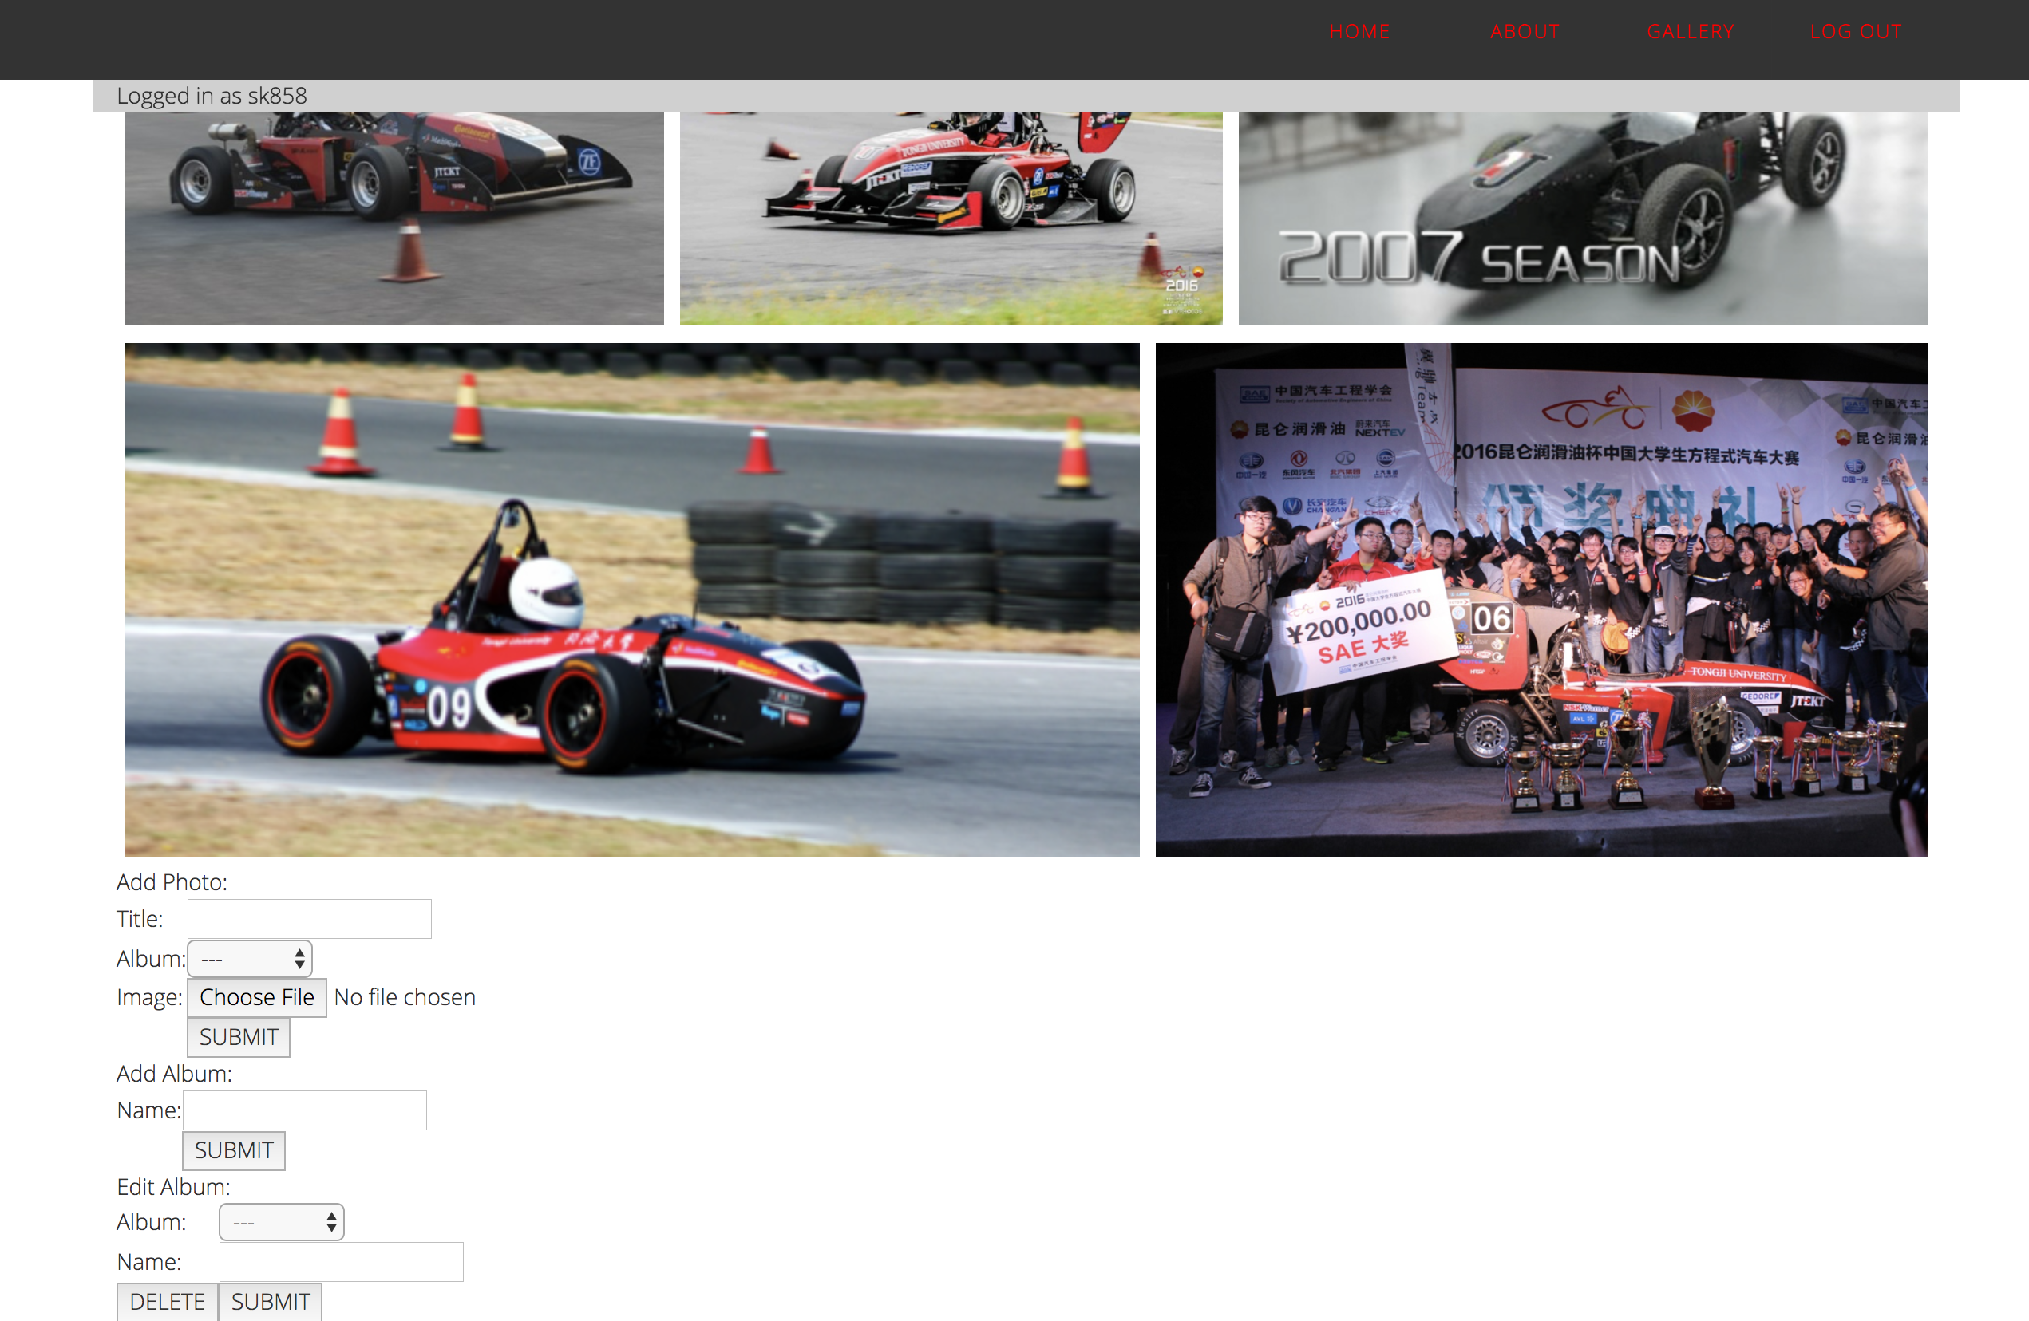
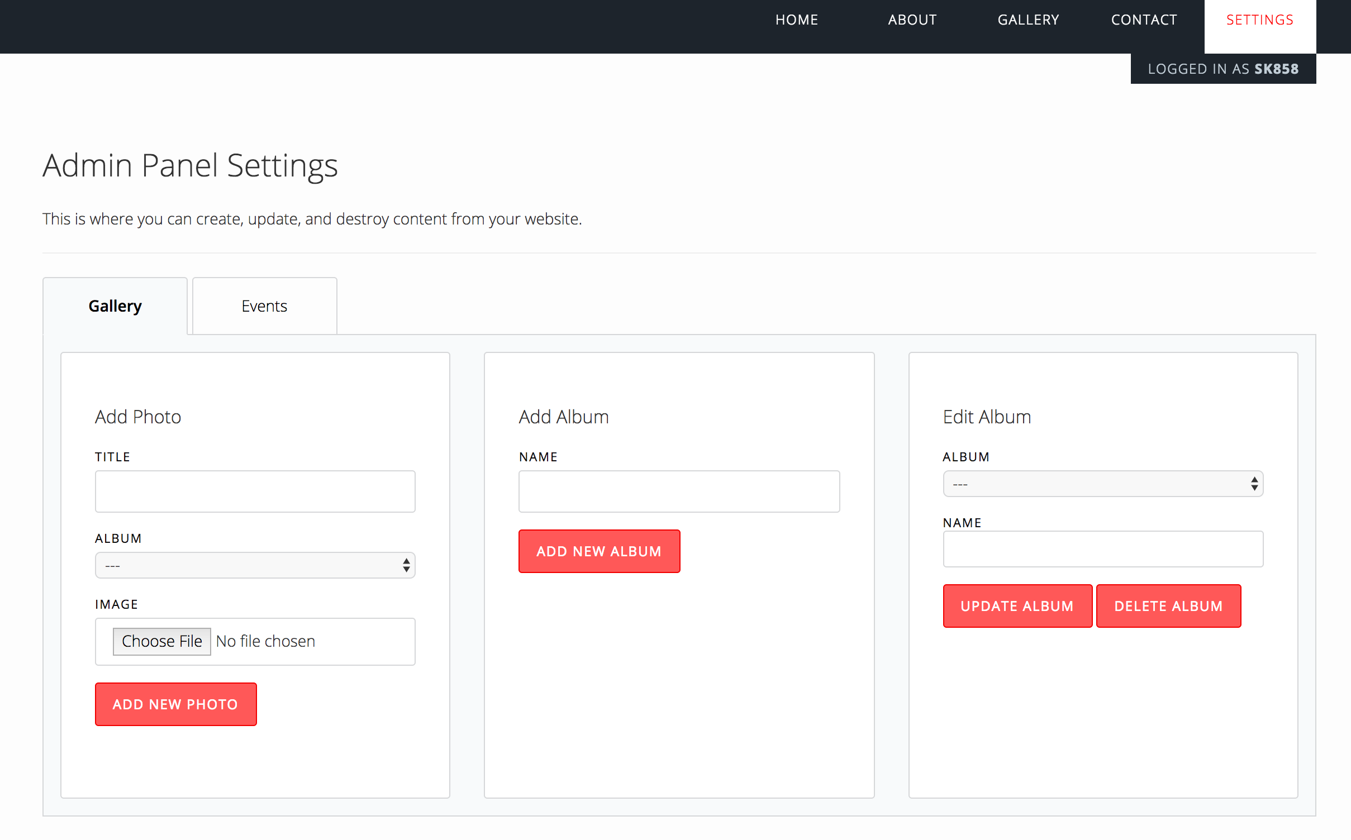
New Settings page for editing job

Slide 11
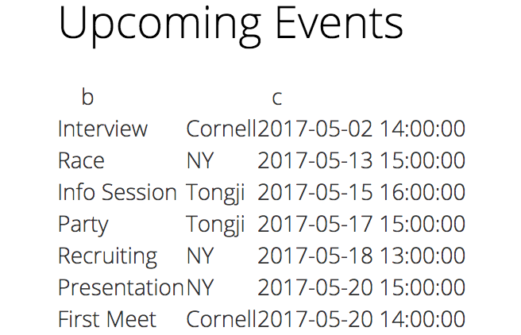
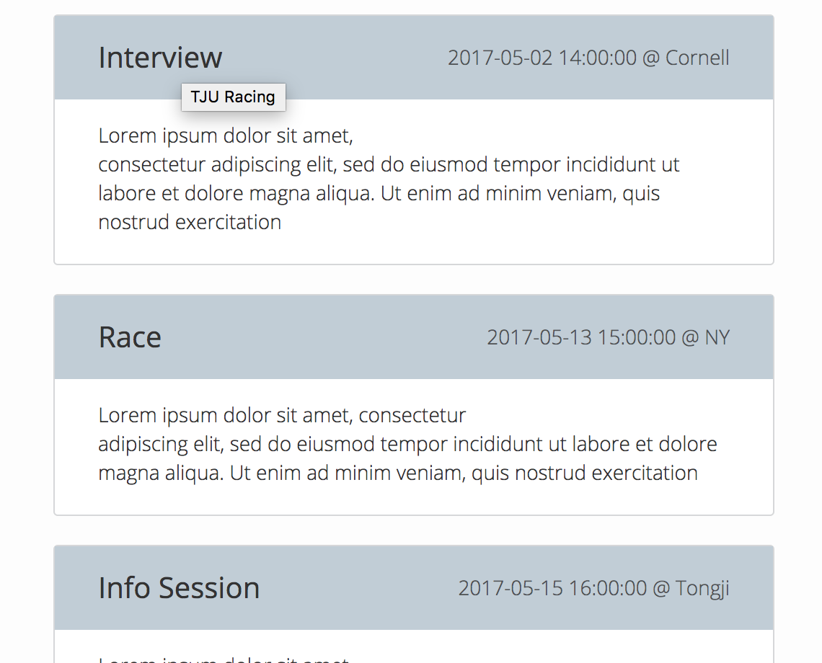
Improvement on Upcoming events

Slide 12

Thank you!

